Slide 1
Wind Energy
Ahmed Mohamed and William Nelson

Slide 2
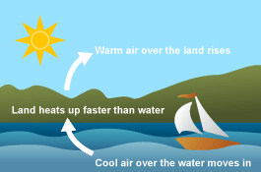

What is Wind Energy?
Wind is caused by uneven heating of the Earth’s atmosphere, which causes high pressure pockets and low pressure pockets. Areas of high pressure move towards areas of low pressure.
Wind Energy is, in a way, another form of Solar Energy because of this
Wind Energy is sustainable so long as both the Earth’s rotation exist and the Earth is heated by the sun

Slide 3
Advantages
No fuel costs
Renewable, clean
Cost-effective ($0.04/kWh)
No limit as to where it can be placed
Doesn’t pollute the air
Sustainable

Slide 4
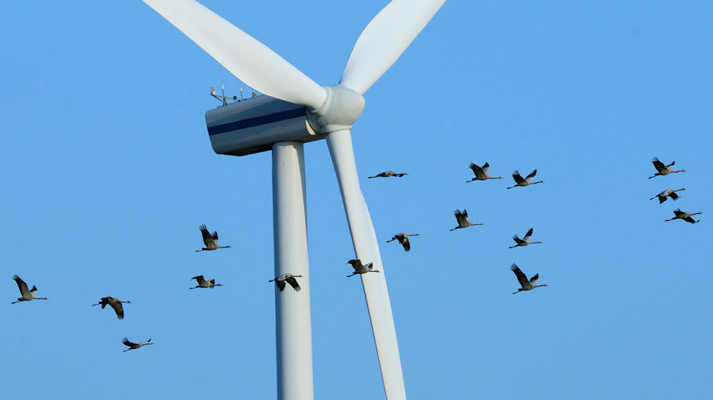
Disadvantages
Reliant on wind; if it isn’t windy, there’s no electricity being generated
~30% efficient
Can harm wildlife (birds)
Noise/Visual pollution

Slide 5
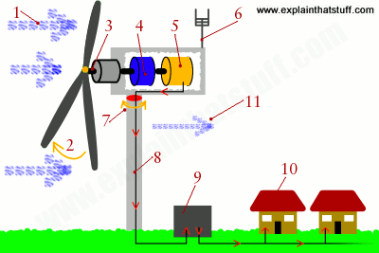
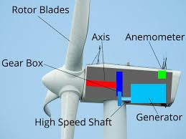
How does it work?
Wind forces the rotor blades to spin which provides electrical power to a generator
Electricity is transferred to other places using power lines
Can be used alongside other energy sources

Slide 6
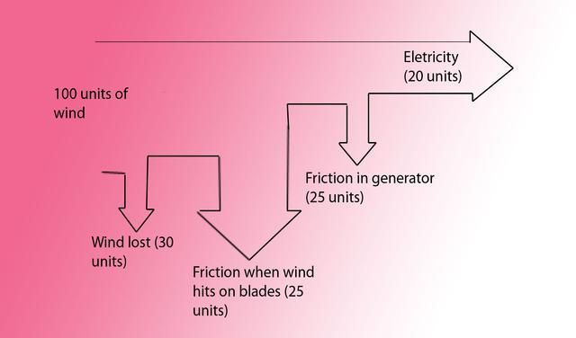
Power output
P = ½CpAV^3
p = Air density
C = Coefficient of performance
A = Frontal area
V = Wind velocity

